Slide 1
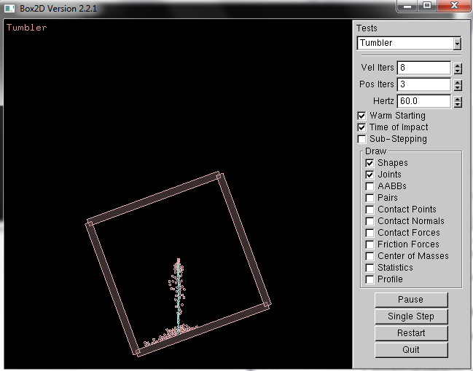
CSE 380 – Computer Game Programming
Box2D
Box2D TestBed

Slide 2
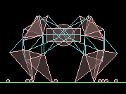
What is Box2D?
A 2D rigid body simulation engine
  i.e. a 2D physics library
Written in C++ with lots of C

Slide 3

Rigid Body Physics?
Not Deformable
Can be translated and rotated
As opposed to?
  Soft Body Physics
http://en.wikipedia.org/wiki/File:Blender3D_HiddenTextSoftbody.ogg

Slide 4
Fundamental Objects and Terms
The core objects used by the system:
  shape (i.e. circle, polygon, etc.)
  rigid body (we know what that is)
  fixture (gives physical properties to shape)
    density, friction, restitution, etc.
  constraint (limits a degree of freedom)
  contact constraint (prevents penetration)
  joint (holds 2 ore more rigid bodies together)
  joint limit (restricts range of motion of joint)
  joint motor (drives motion of connected bodies)
  world (collection of bodies, fixtures, & constraints)
  solver (advances time and resolves constraints)
  First TOI (time of impact)

Slide 5
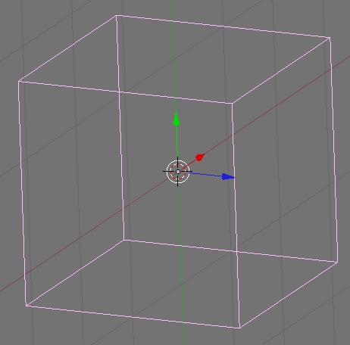
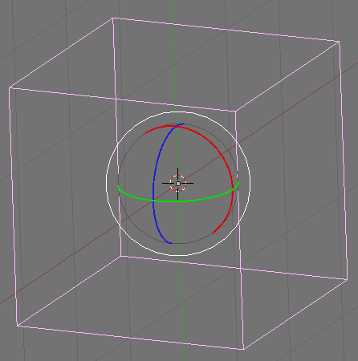
Degrees of Freedom?
How many degrees of freedom does a 3D object have?
  6 (3 translate, 3 rotate)

Slide 6
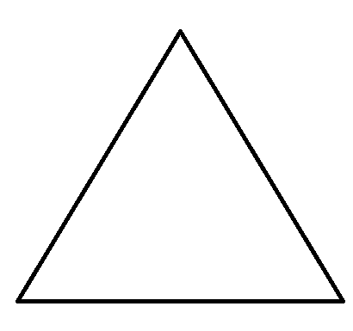
How about a 2D object?
  3 (2 translate, 1 rotate
  Constrain a degree of freedom?
  Ex: pin object to wall
    it can rotate but not translate

Slide 7
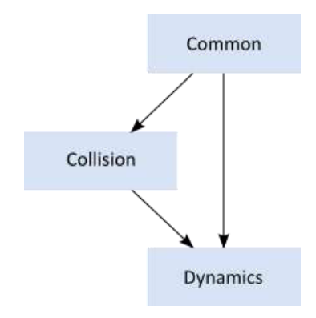
Box2D Modules
Common
  memory allocation
  math
  settings
Collision
  defines shapes
  broad phase
  collision functions & queries
Dynamics
  simulation world
  bodies, fixtures, & joints
  Box2D module dependencies

Slide 8
Box2D Units
Uses MKS units system
  meters-kilograms-seconds
  radians for angles
  floating point numbers w/ tolerances
Recommended sizes:
  moving objects: 0.1 to 10 meters
  static objects: 50 meters
But what if you want to use pixels?
  render using your own scaling system

Slide 9
The Memory Factory
Box2D manages all memory
What if you want a new body or joint?
  ask the world, it uses the factory pattern
b2Body* b2World::CreateBody(const b2BodyDef* def)
b2Joint* b2World::CreateJoint(const b2JointDef* def)
void b2World::DestroyBody(b2Body* body)
void b2World::DestroyJoint(b2Joint* joint)
b2Body objects can make b2Fixture objects
b2Fixture* b2Body::CreateFixture(const b2FixtureDef* def)
void b2Body::DestroyFixture(b2Fixture* fixture)

Slide 10
Box2D’s SOA
SOA?
  Small Object Allocator
Problem: Allocating lots of small objects via malloc or new is bad. Why?
  memory fragmentation
  memory search cost
So, never new or malloc, ask the SOA
  b2BlockAllocator

Slide 11
b2BlockAllocator
The b2World has one
Maintains growable pools of memory blocks
What does it do:
  when a request is made for a block?
    The SOA returns a best-fit block
  when a block is freed?
    The SOA returns it to the pool
Both operations are fast and cause little heap traffic

Slide 12
What if you want to attach data?
We have the void*
b2Fixture, b2Body, b2Joint
  all have void* instance variables
So what? What can it hold?
  the address of anything

Slide 13
Why would you want to attach data?
Think AI and your Bots. Ex:
  apply damage to a bot using a collision result
  play a scripted event if the player is inside an AABB
  access a game structure when Box2D notifies you that a joint is going to be destroyed
Attaching data ex:
MyBot *bot = new MyBot();
b2BodyDef bodyDef;
bodyDef.userData = bot;
bot->body = box2Dworld->CreateBody(&bodyDef);

Slide 14
Getting up and Running
Look at HelloWorld
This example creates two objects:
  large ground box
  small dynamic box
Note that it doesn’t render them

Slide 15
Steps for getting started
Define a gravity vector
Create a world
Create a Ground Box
Create a Dynamic Body
Setup the integrator
Setup the constraint solver

Slide 16
Steps for getting started
Define a gravity vector. Ex:
  b2Vec2 gravity(0.0f, -10.0f);
Create a world (i.e. b2World)
  the physics but that manages memory
  put it where you like (stack, heap, global). Ex:
  bool doSleep = true;
  b2World world(gravity, doSleep);
Now let’s add stuff to the world. What? Bodies

Slide 17
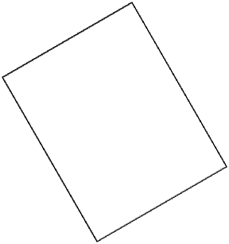
Adding bodies to the world
What’s a body?
  a rigid body
  i.e. a bounding volume
To do so:
  Define a body with position, damping, etc.
  Use the world object to create the body.
  Define fixtures with a shape, friction, density, etc.
  Create fixtures on the body.

Slide 18
So let’s continue
Create a Ground Box
b2BodyDef groundBodyDef;
groundBodyDef.position.Set(0.0f, -10.0f);
b2Body* groundBody = world.CreateBody(&groundBodyDef);
b2PolygonShape groundBox;
groundBox.SetAsBox(50.0f, 10.0f);
groundBody->CreateFixture(&groundBox, 0.0f);
Note that
What’s the width and height of the ground box?
  100 x 20
  note that by default, bodies:
    are static
    have no mass

Slide 19
And let’s add a dynamic body
Create a Dynamic Body
  set the body type to b2_dynamicBody if you want the body to move in response to forces
b2BodyDef bodyDef;
bodyDef.type = b2_dynamicBody;
bodyDef.position.Set(0.0f, 4.0f);
b2Body* body = world.CreateBody(&bodyDef);
b2PolygonShape dynamicBox;
dynamicBox.SetAsBox(1.0f, 1.0f);
b2FixtureDef fixtureDef;
fixtureDef.shape = &dynamicBox;
fixtureDef.density = 1.0f;
fixtureDef.friction = 0.3f;
body->CreateFixture(&fixtureDef);

Slide 20
Setup the integrator and constraint solver
What’s the integrator?
  simulates the physics equations
  does so at timed intervals
    i.e. your frame rate
What do you need to do?
  specify the time step
  recommendation: at least 60 Hz for physics systems

Slide 21
And the constraint solver?
  constraint (limits a degree of freedom)
The constraint solver solves all the constraints in the simulation, one at a time.
A single constraint can be solved perfectly.
When we solve one constraint, we slightly disrupt other constraints.
To get a good solution, we need to iterate over all constraints a number of times.

Slide 22
Done in 2 phases
Velocity phase:
  Solver computes impulses necessary for bodies to move correctly
Position phase:
  Solver adjusts positions of the bodies to reduce overlap and joint detachment
Each phase has its own iteration count
  Recommendation: 8 for velocity, 3 for position

Slide 23
Finishing up our steps
Setup the integrator
float32 timeStep = 1.0f / 60.0f;
6. Setup the constraint solver
int32 velIterations = 6;
int32 posIterations = 2;
…
// EACH FRAME
world.Step(timeStep, velIterations, posIterations);

Slide 24
Hello World
Here’s our game loop
for (int32 i = 0; i < 60; ++i)
{
world.Step(timeStep, velIterations, posIterations);
b2Vec2 position = body->GetPosition();
float32 angle = body->GetAngle();
printf("%4.2f %4.2f %4.2f\n",
position.x, position.y, angle);
}

Slide 25
References
Box2D v2.2.1 User Manual
  Copyright © 2007-2011 Erin Catto

